Slide 1
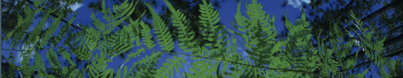

02- Occurrence Record Cleaning
Shelly Gaynor
University of Florida

Slide 2
Occurrence data cleaning
02_ Occurrence_Data_Cleaning.R
0. Exploring the dataset
Resolve taxon names
Clean localities
Precision
Remove impossible points
Most common coordinate: 0.00, 0.00
Cultivated zones, botanical gardens, etc
Remove duplicates
Spatial correction
Visualize
Save cleaned.csv
- REPEAT -

Slide 3
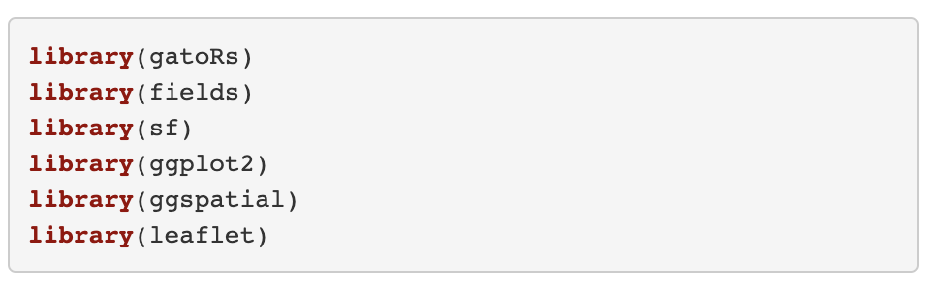
Load Packages
gatoRs custom package for processing biodiversity data
Geospatial packages include sf and fields
ggplot2, ggspatial, and leaflet are for visualization

Slide 4
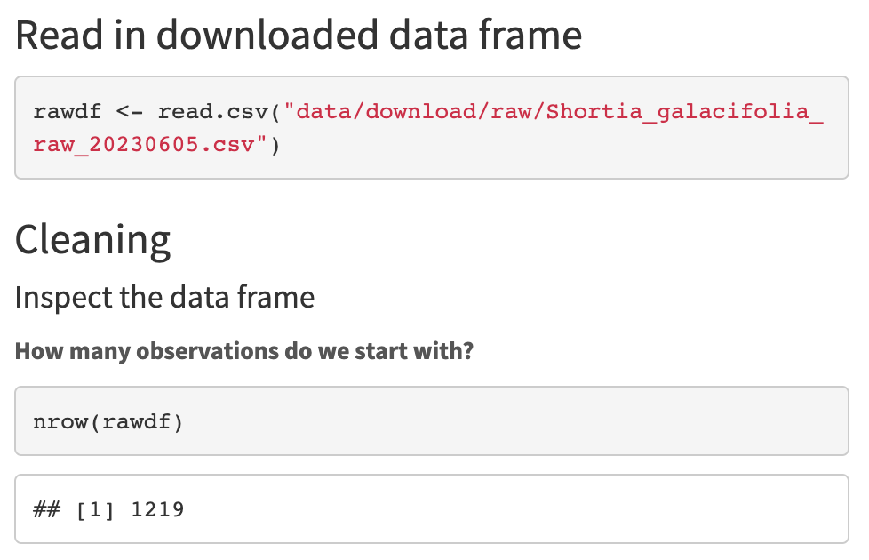
Load Data File
read.csv is a base function of R, it reads csv files

Slide 5
Look at the Data File
nrow print the number of rows

Slide 6
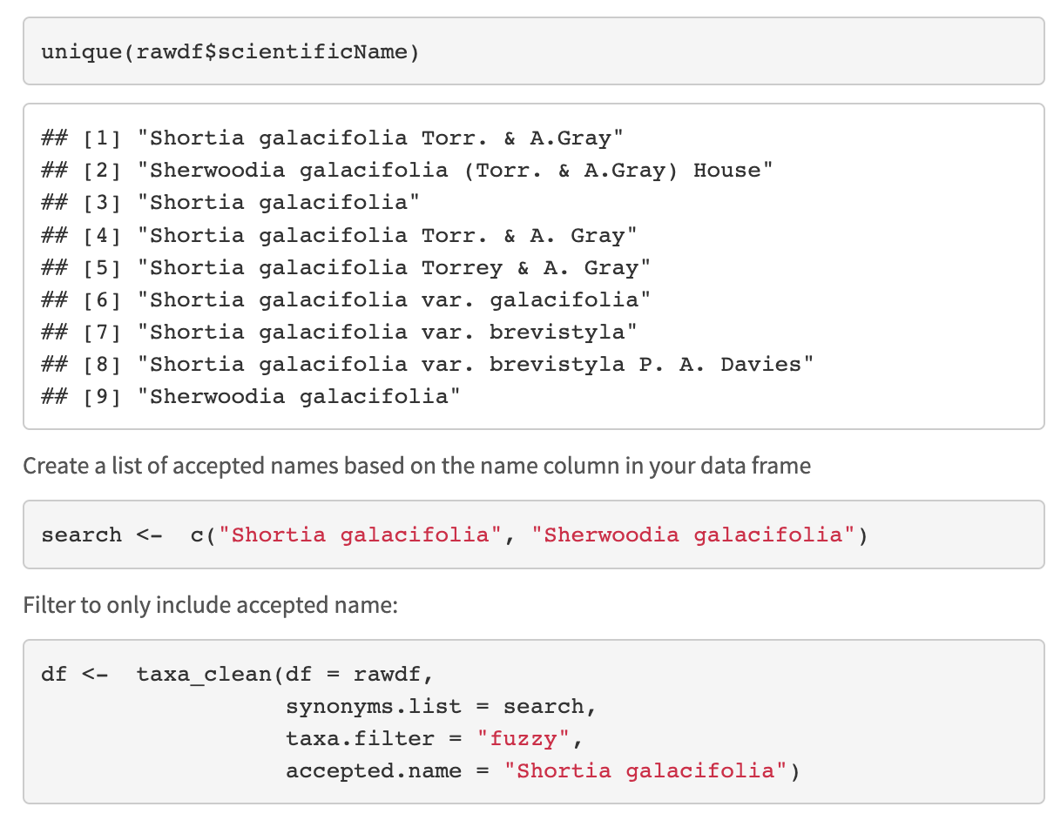
1. Resolve taxon names
unique prints unique values in the column name from the dataframe rawdf.
c creates a list stored in the object search that contains “Shortia galacifolia” and “Sherwoodia galacifolia”

Slide 7
1. Resolve taxon names
Here we are going to harmonize taxonomy using taxa_clean().
This function has three filter options: exact, fuzzy, or interactive.

Slide 8
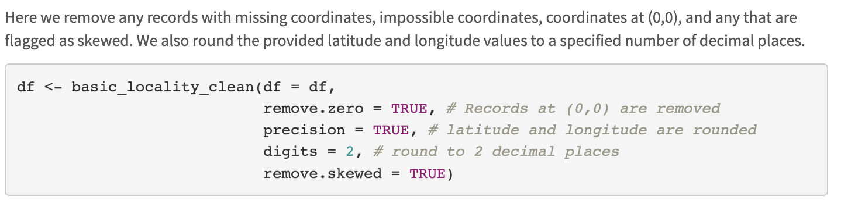
2. Clean localities
basic_locality_clean() is from the package gatoRs

Slide 9
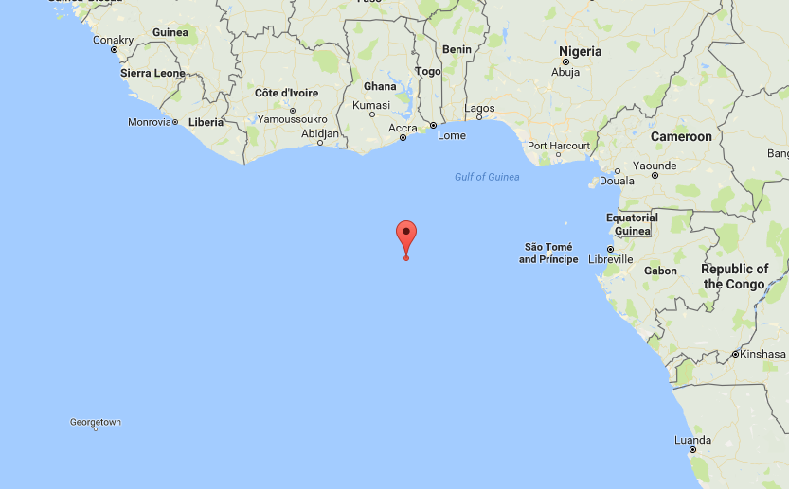
2. Clean localities
Only retains records in the column long/lat that are not (!=) equal to 0.00
”There’s no place like 0,0”

Slide 10
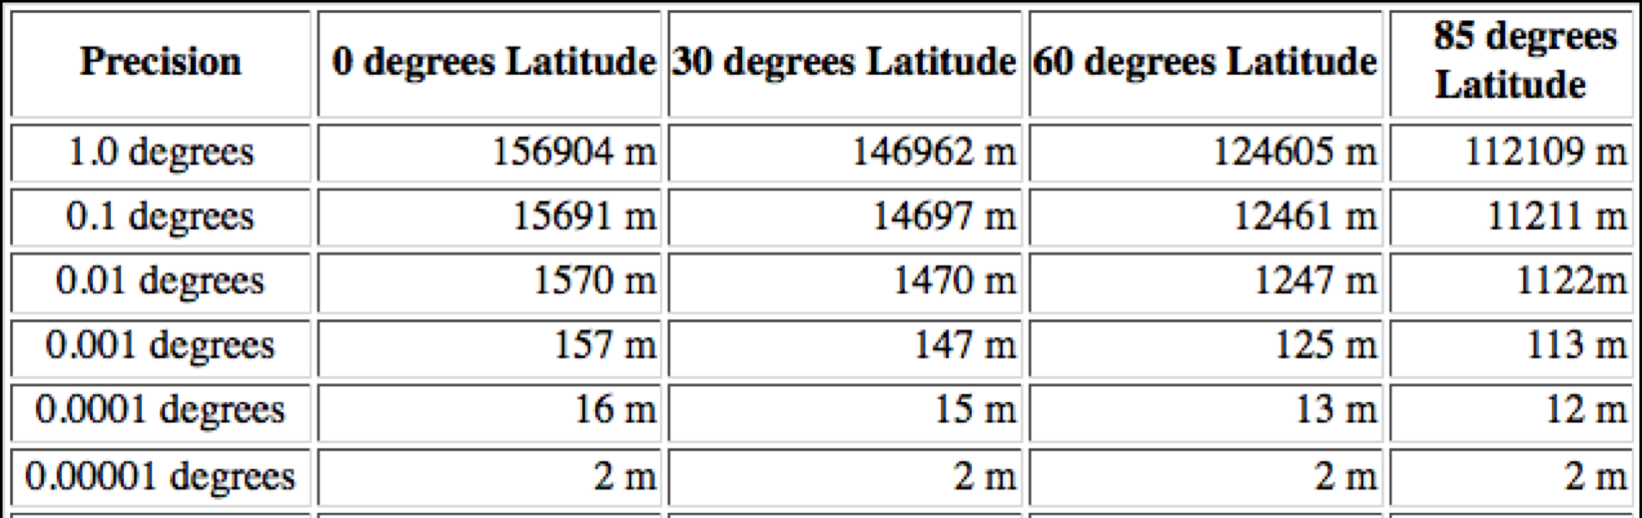
2. Clean localities
Our climate layers are 30 arc-sec resolution which is about 1000 meters

Slide 11
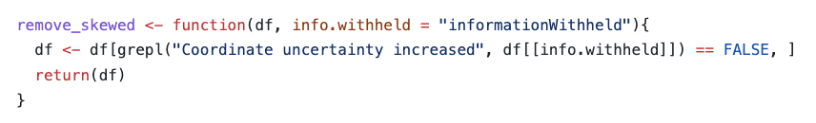
2. Clean localities
The skewed records can be identified with based on the ‘InformationWitheld’ column.

Slide 12
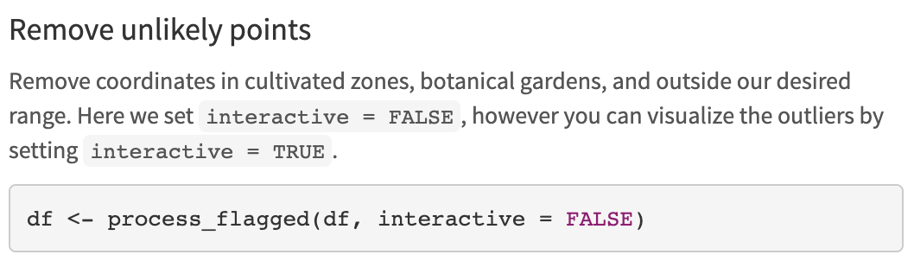
2. Clean localities
Removes points in a radius
around biodiversity institutions
Zizka et al. 2019. CoordinateCleaner: Standardized cleaning of occurrence records from biological collection databases. Methods in Ecology and Evolution.

Slide 13
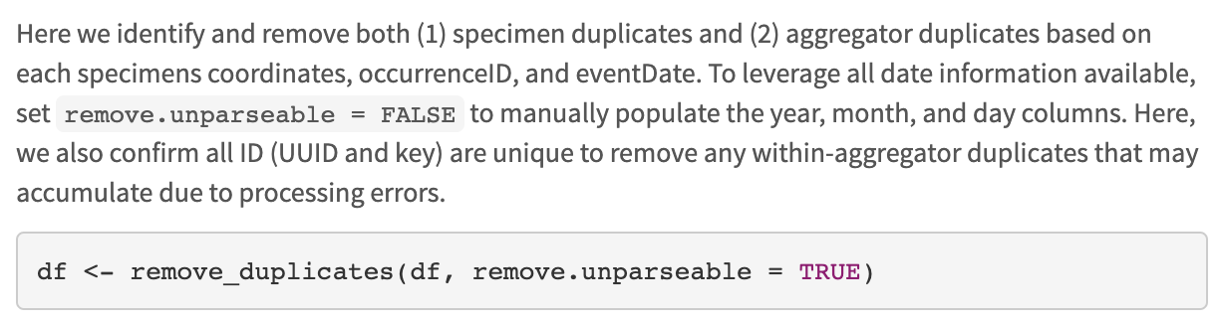
3. Remove Duplicates
parsedate is a beautiful package that parses dates – However, it only parses dates after 1970!
Try remove.unparable = FALSE

Slide 14
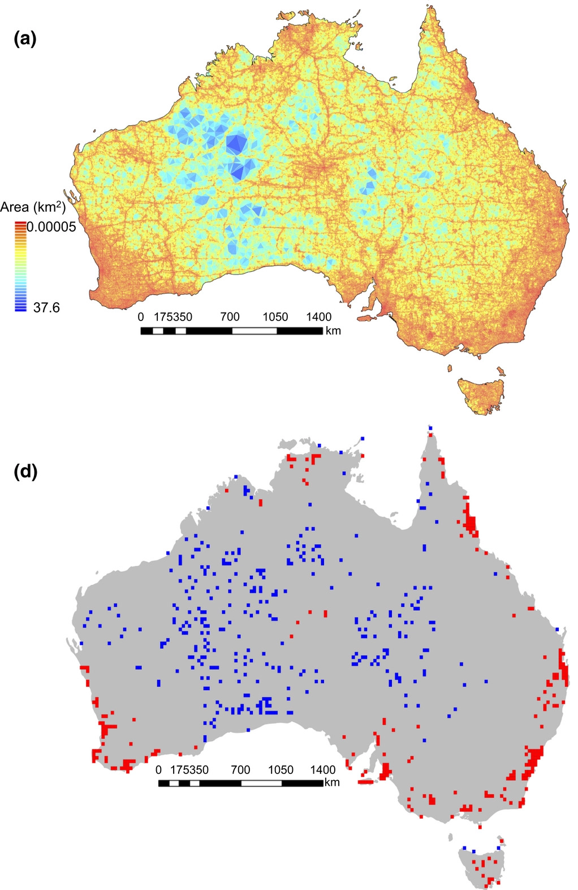
Sampling bias for
857,245 records
4. Spatial Correction
Filtering is a procedure to reduce the clustering of species records
Collection efforts can lead to clustering of points
Daru et al. 2017. Widespread sampling biases in herbaria revealed from large-scale digitization. New Phytologist.
Notes:
Filtering is a procedure to reduce the clustering of species records .
Figure shows hotspots related to

Slide 15
4. Spatial Correction
Filtering is a procedure to reduce the clustering of species records
Collection efforts can lead to clustering of points
After filtering, there may still be spatial autocorrelation
This can be accounted for by data partitioning
Distance
Env. Similarity
Sillero N. and A. M. Barbosa. 2020. Common mistakes in ecological niche models. International Journal of Geographical Information Science.
Notes:
Filtering is a procedure to reduce the clustering of species records

Slide 16
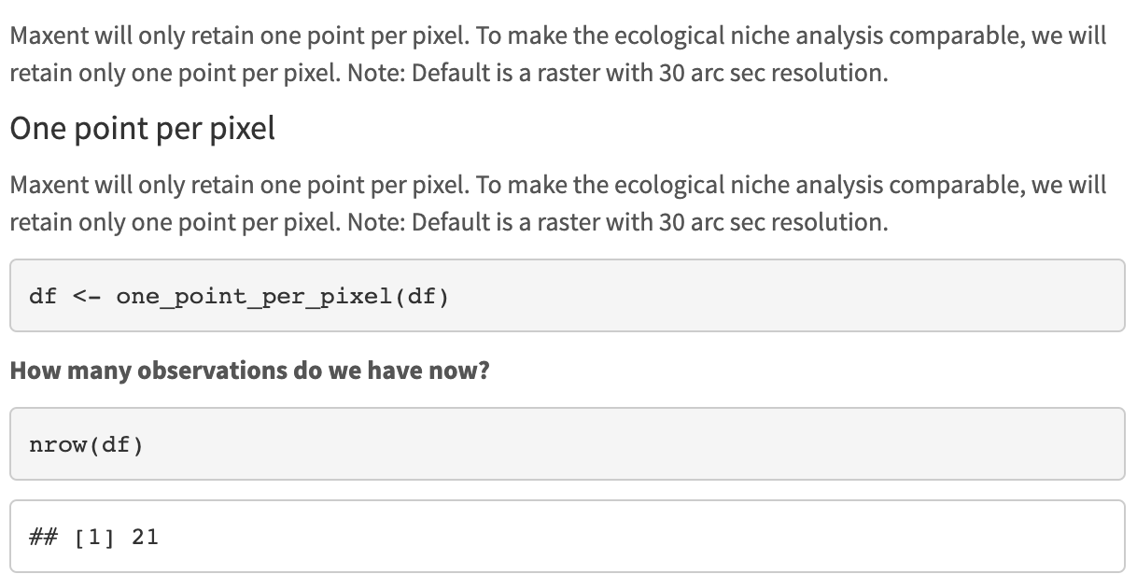
4. Spatial Correction
Notes:
Filtering is a procedure to reduce the clustering of species records

Slide 17
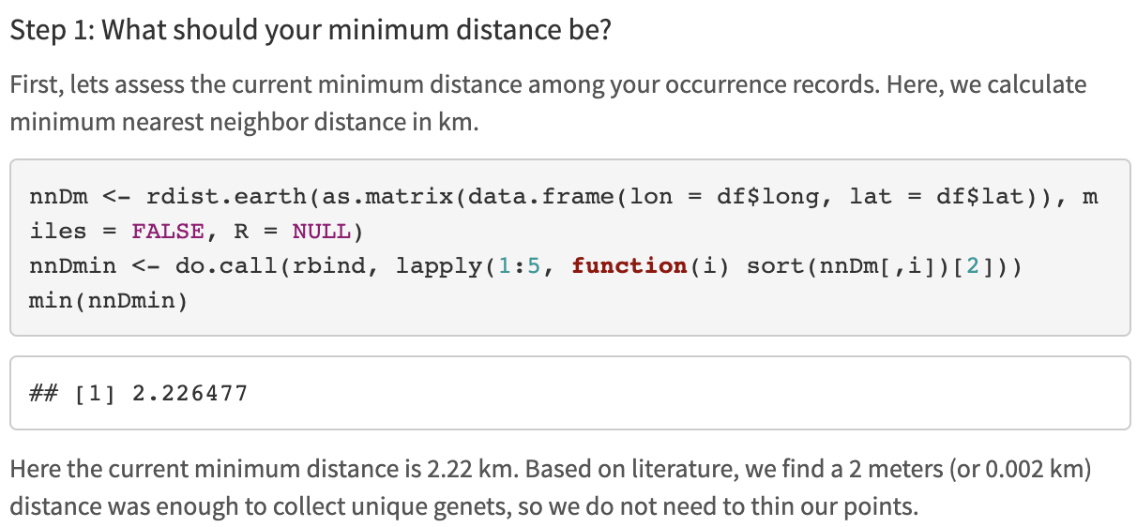
4. Spatial Correction
rdist.earth can be used to look at nearest neighbor distance in kilometers
do.call applies to a list, rbind binds rows, and the sort is set up to select the lowest value.
We want to look at the min distance between points remaining

Slide 18
4. Spatial Correction
spThin function thin
Set thin.par = minimum nearest neighbor distance
Next, the function calculates pairwise distance between all records
Then:
1) For each record, IDs the # of occurrence records within distance thin.par
2) One record of those which share the greatest # from (1) is removed at random.
3) Repeat 1 – 2 till no record has a nearest neighbor closer than thin.par
Aiello-Lammens et al. 2015. spThin: an R package for spatial thinning of species occurrence records for use in ecological niche models. Ecography.

Slide 19
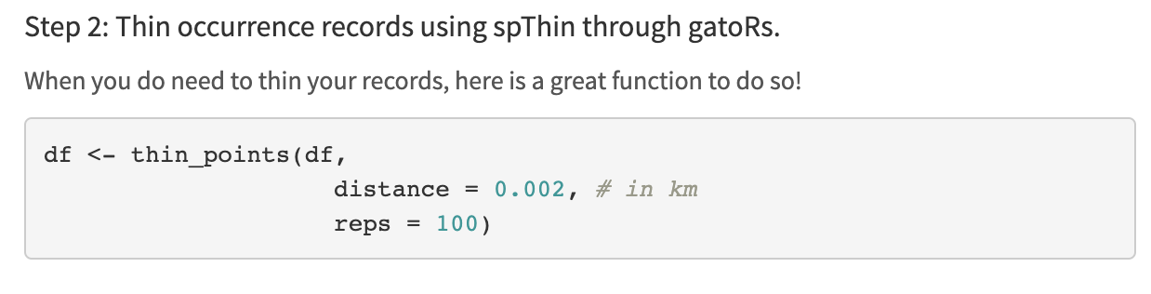
4. Spatial Correction

Slide 20
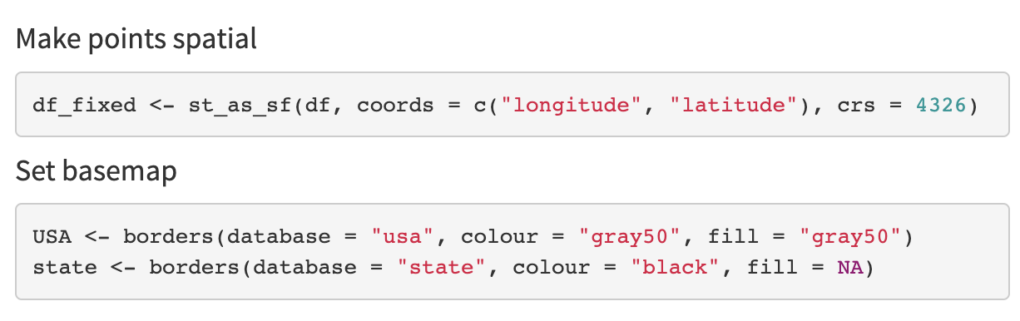
5. Plot Cleaned Records
crs = 4326 is WGS84
Using the function borders from the package ggplot2, we download basemaps to plot our points on.

Slide 21
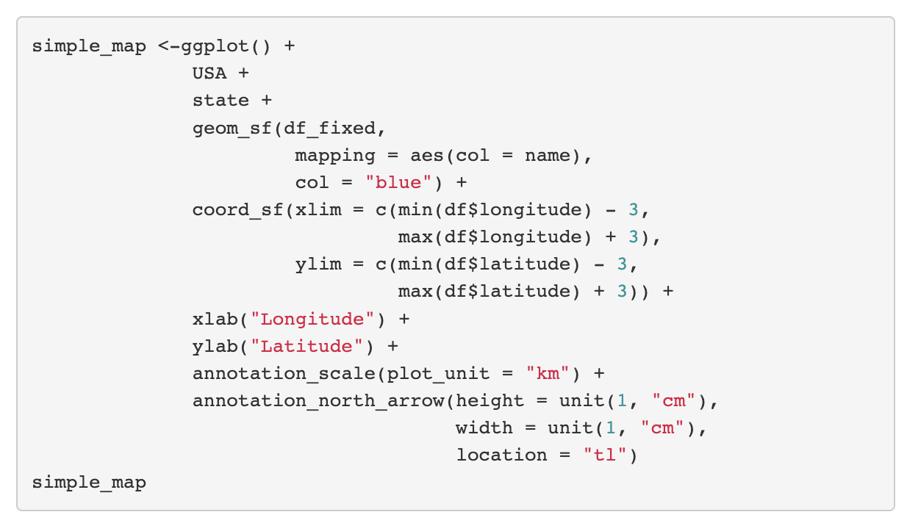
5. Plot Cleaned Records
1. Add basemaps
2. Add points
3. Zoom in
4. Fix axis labels
5. Add scale and North arrow

Slide 22
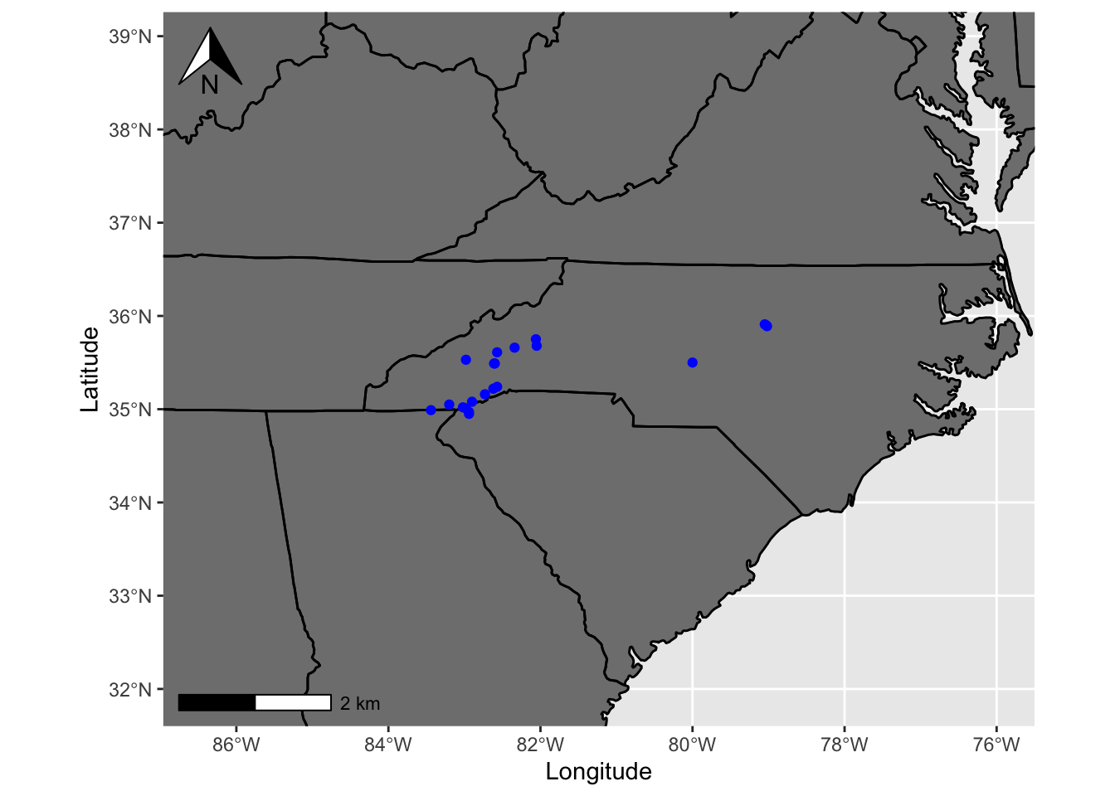
5. Plot Cleaned Records

Slide 23
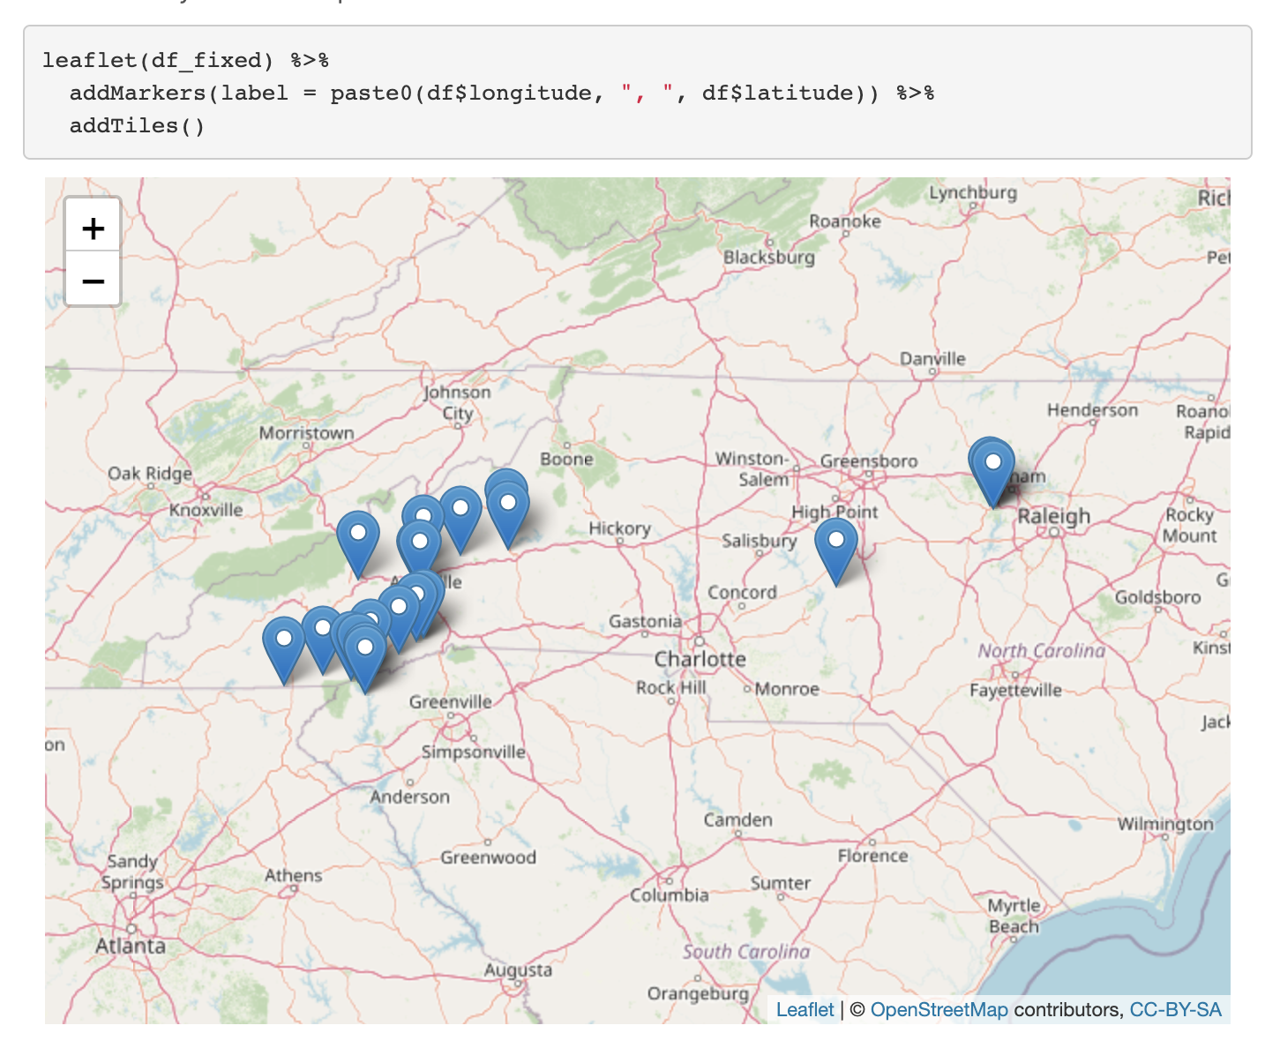
5. Plot Cleaned Records

Slide 24
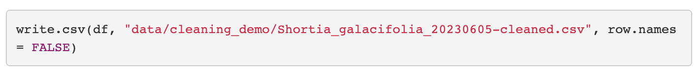
6. Saved Cleaned.csv

Slide 25
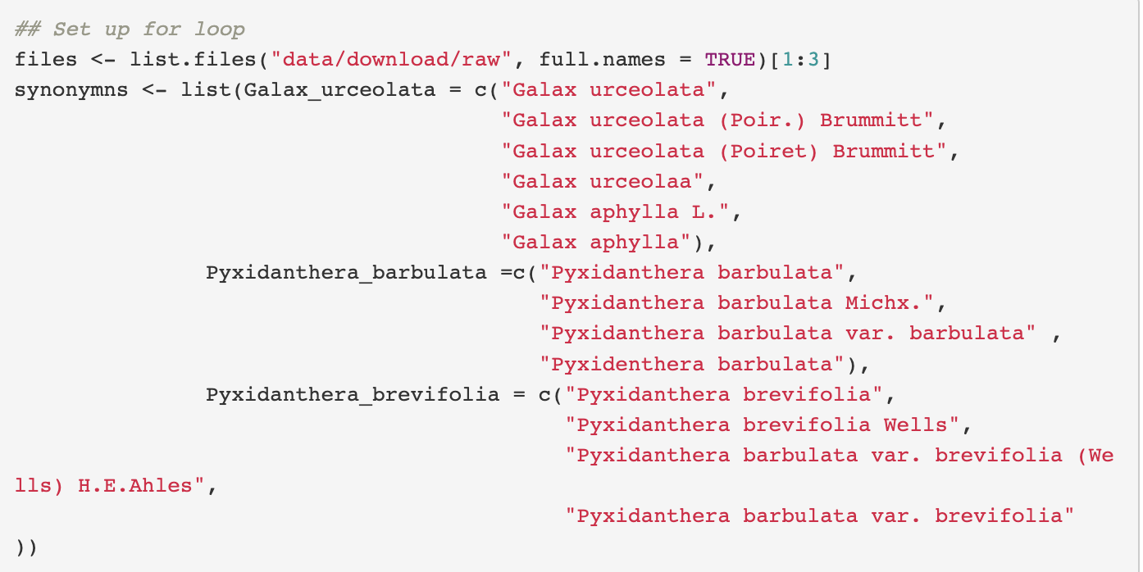
7. Repeat for all taxa
1. Create list of files with paths
2. Create list of synonyms

Slide 26
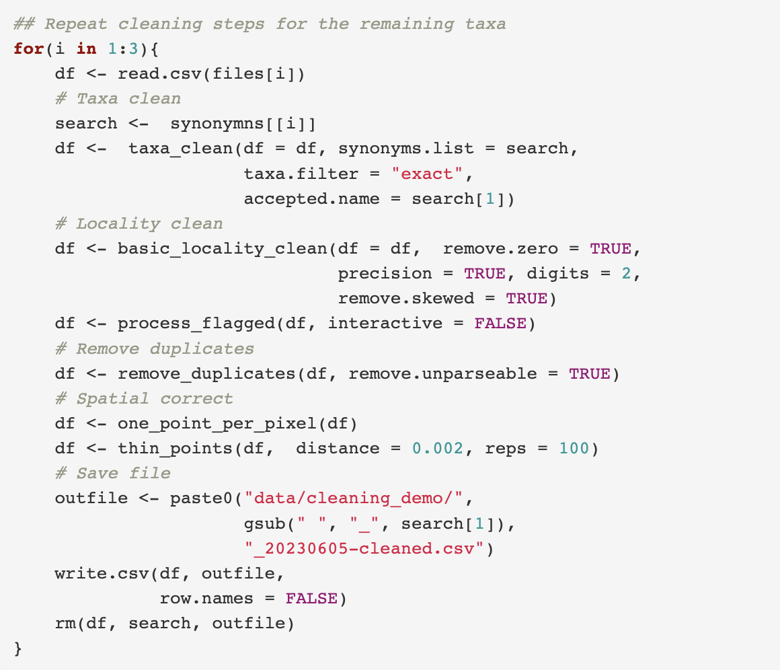
7. Repeat for all taxa
0. Read in downloaded data
Resolve taxon names
Clean localities
Precision
Remove impossible points
Most common coordinate: 0.00, 0.00
Cultivated zones, botanical gardens, ect.
Remove duplicates
Spatial correction
Visualize
Save cleaned.csv

Slide 27
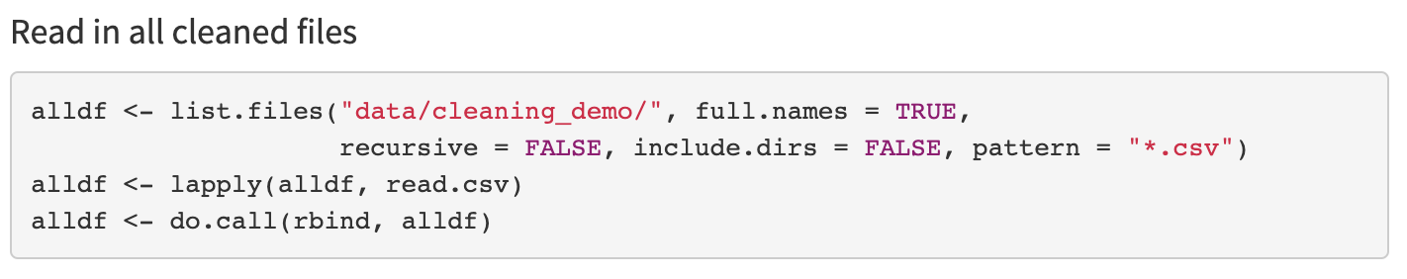
8. Make Maxent Ready

Slide 28
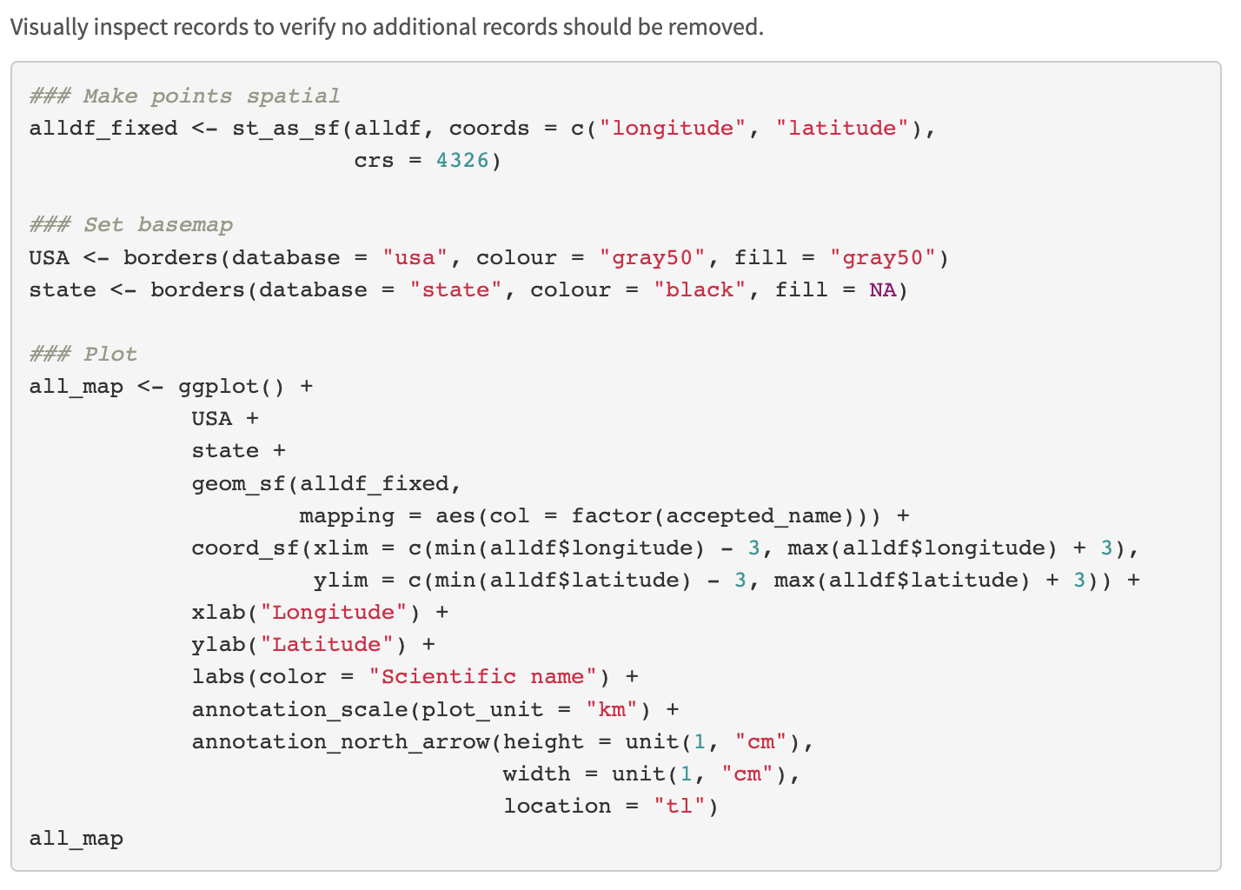
8. Make Maxent Ready

Slide 29
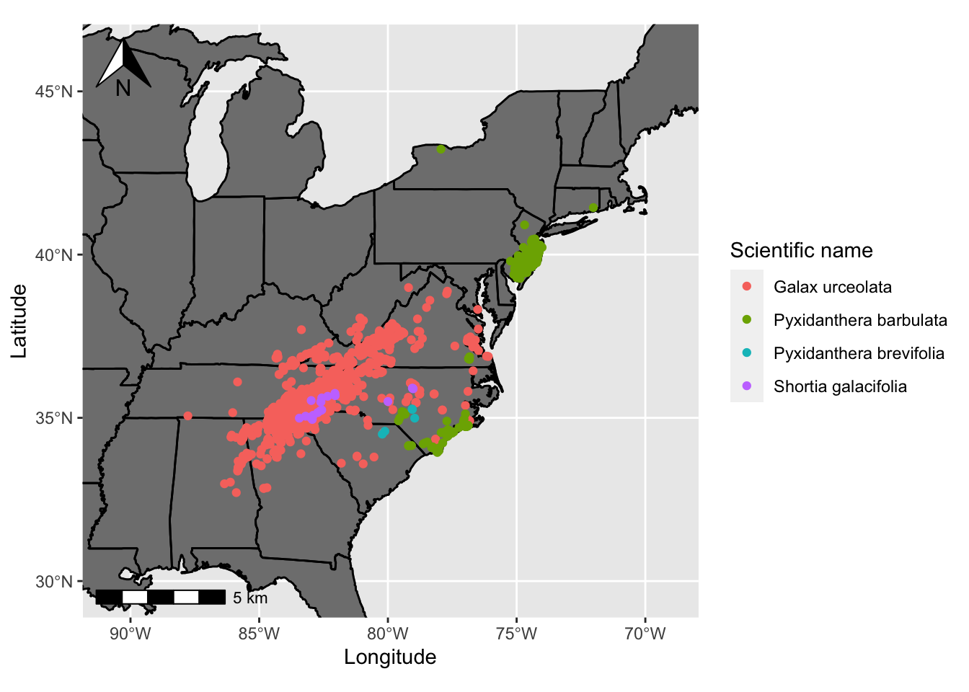
8. Make Maxent Ready

Slide 30
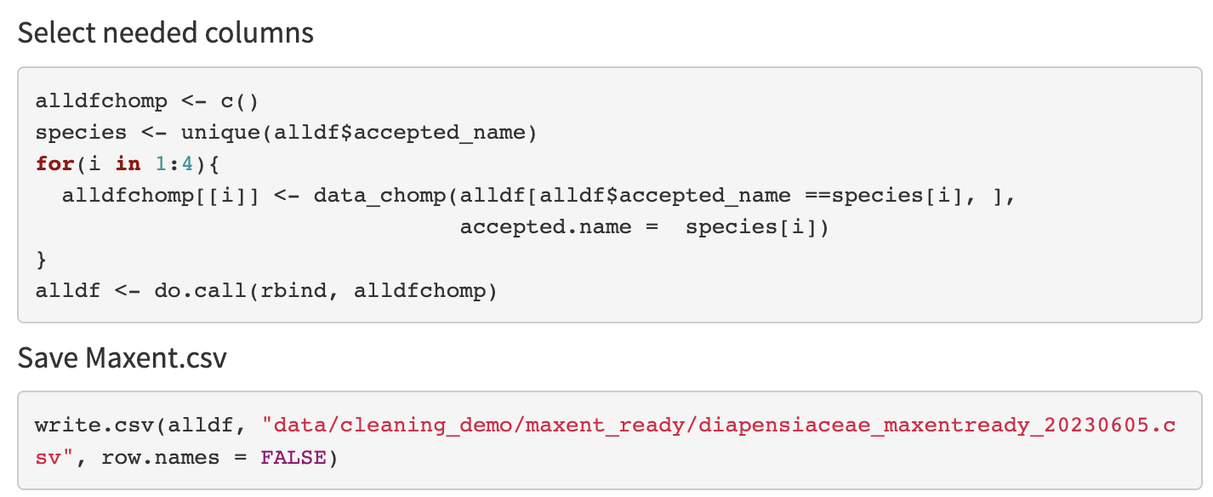
8. Make Maxent Ready

Slide 31
Minimum occurrence records
Your points should represent the env. variability true to your species.
Too few points may not classify your species suitable conditions properly.
It is not clear the minimum number of points needed.
Might be dependent on the extent of the study area
3, 4, or 5 have been suggested
5 per env. variable has also been suggested
More env. variables may not significantly change the minimum sample size needed (see study below).
Proosdij et al. 2016. Minimum required number of specimen records to develop accurate species distribution models. Ecography.

